Slide 1
Best practices for supporting individuals with autism spectrum disorder
Sophie Maleng, MN, ARNP

Slide 2
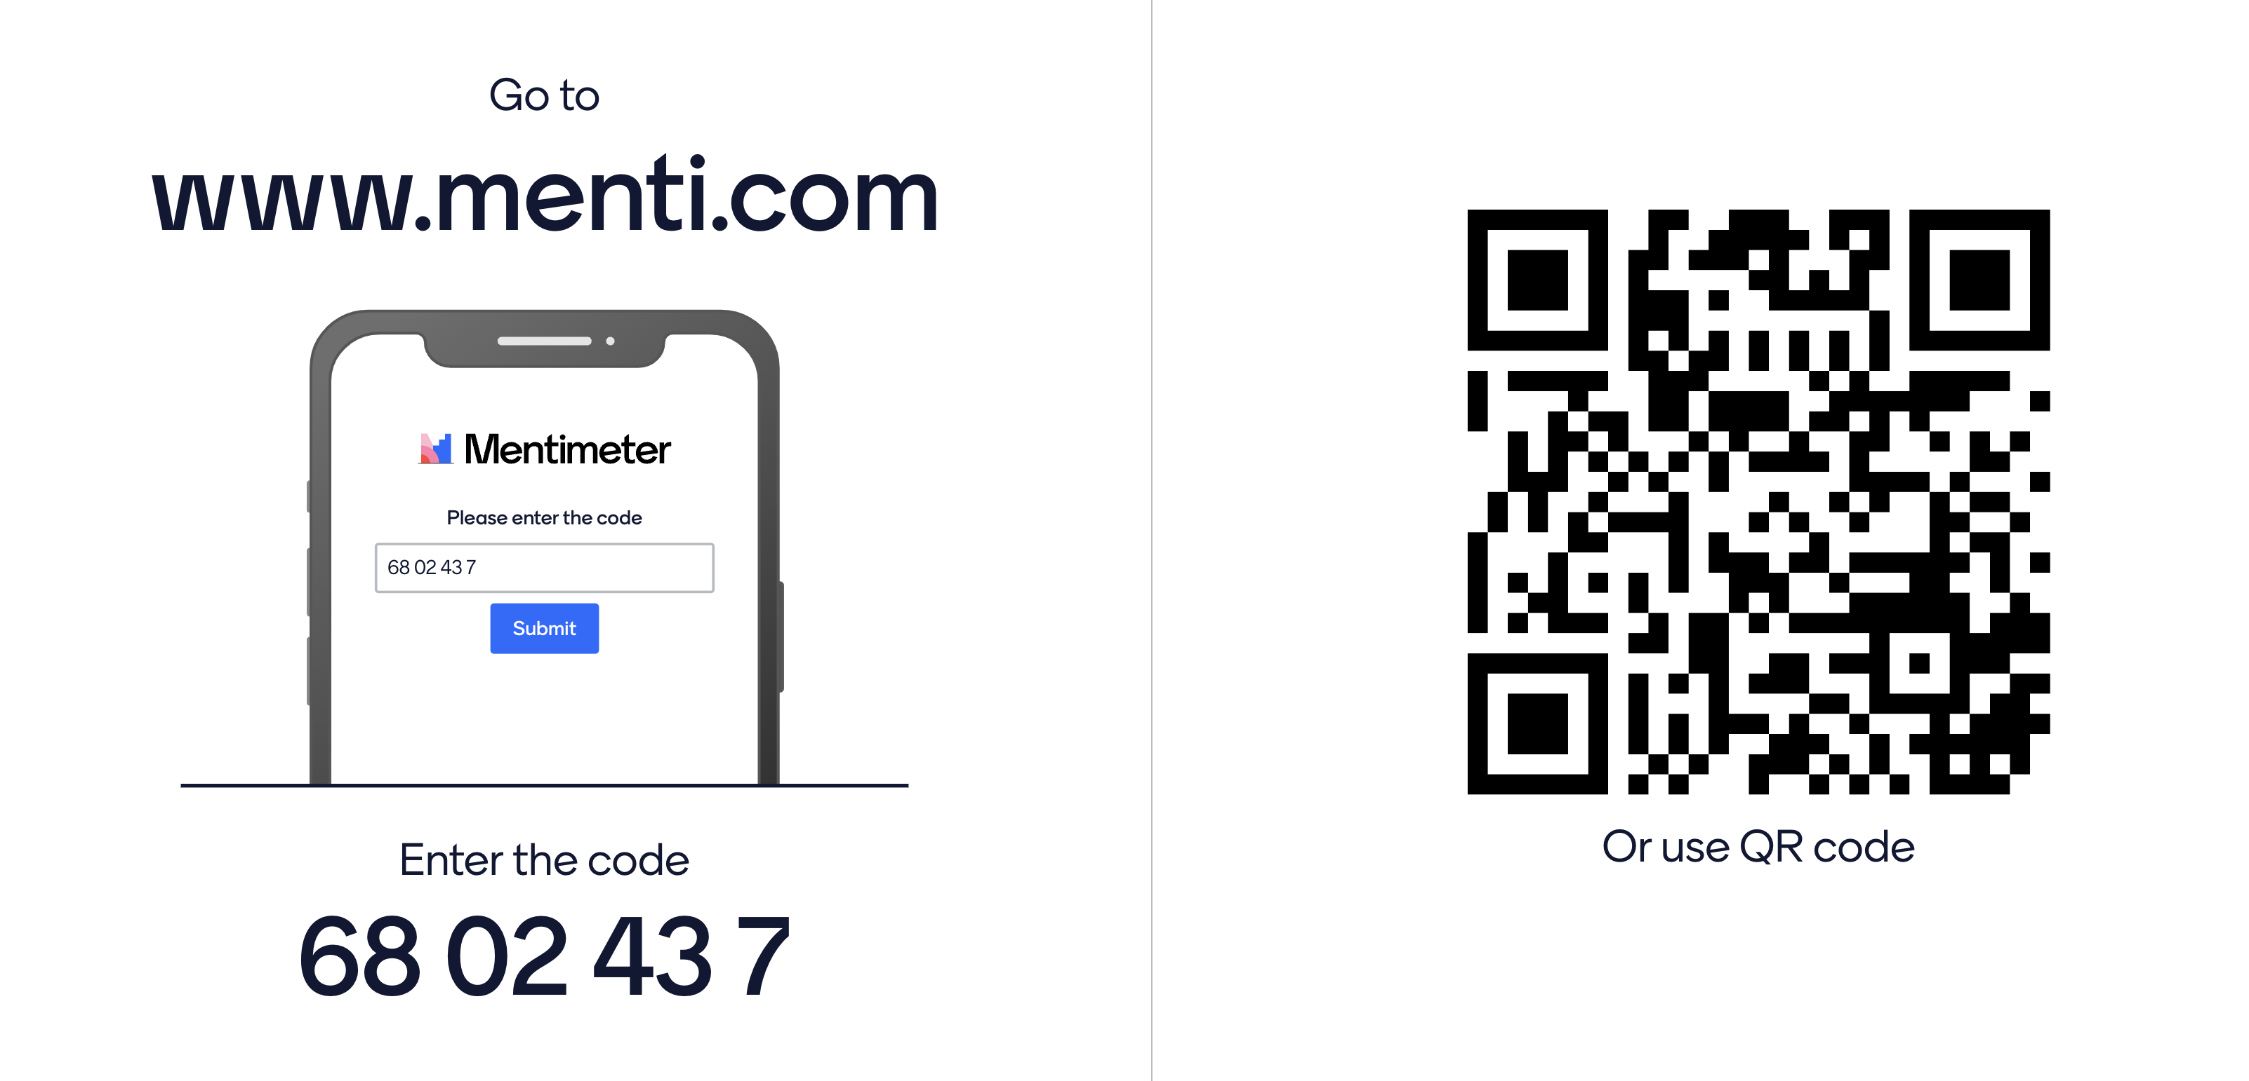
Poll on Mentimeter – Do you know a person with autism?
Notes:
Voting Link: https://www.menti.com/alcqy16mm8n6

Slide 3
Overview of Autism Spectrum Disorder (ASD)
Autism spectrum disorder (ASD) is a condition related to brain development that results in persistent challenges with social communication, restricted interests, and repetitive behavior.
U.S. Prevalence Data:
About 1 in 31 (3.2%) children aged 8 years has been identified with ASD.
ASD is more than 3 times more common among boys than among girls.
ASD is reported to occur in all racial, ethnic, and socioeconomic groups.
Notes:
Prevalence according to estimates from CDC’s Autism and Developmental Disabilities Monitoring (ADDM) Network
Source: https://www.cdc.gov/autism/data-research/index.html
Last time 2022: About 1 in 44 children has been identified with ASD. ASD is more than 4 times more common among boys than among girls.

Slide 4
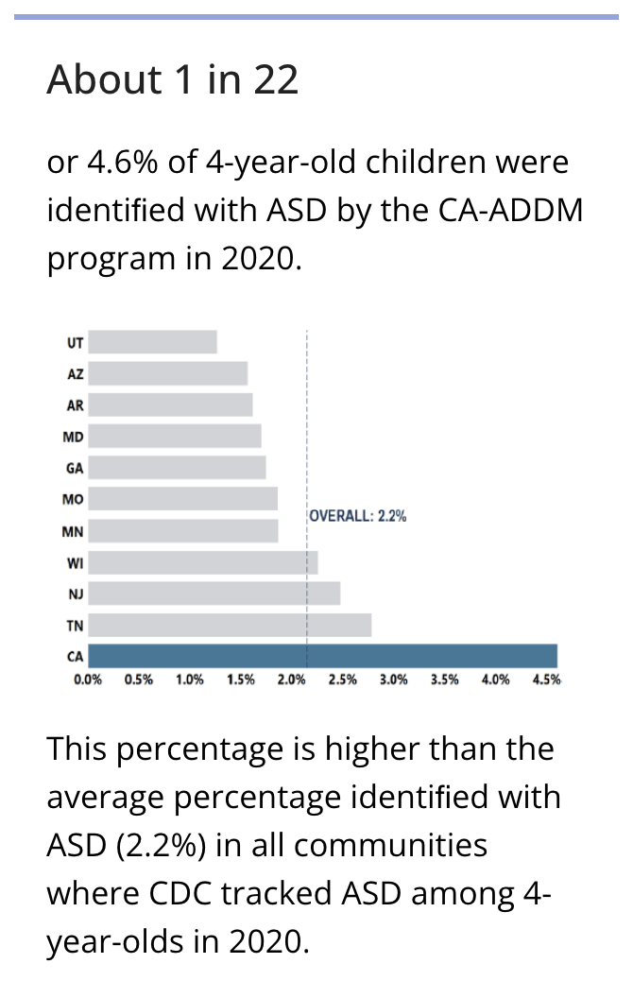
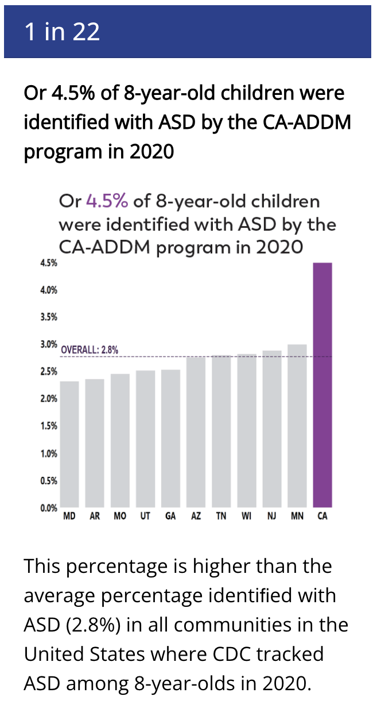
California
ASD prevalence data
Notes:
The percentage of children identiﬁed with ASD is higher in California compared to other sites where CDC tracks ASD for both 4-year-old and 8-year-old children.
More children with ASD in California received their ﬁrst diagnosis at a younger age than in other sites. Additionally, the co-occurrence of intellectual disabilities is lower for both 4-year-old and 8-year-old children identiﬁed with ASDin California than in other sites.
Source: https://archive.cdc.gov/#/details?url=https://www.cdc.gov/ncbddd/autism/addm-community-report/california.html

Slide 5
ASD and Asthma
The research literature is inconclusive as to whether there is a higher incidence of asthma for autistic individuals
Given the increasing prevalence of ASD, there is a good chance you will work with an autistic client

Slide 6
ASD Criteria From DSM-5
Deficits in social communication and interaction
1. Deficits in social-emotional reciprocity
2. Deficits in nonverbal communicative behavior
3. Deficits in developing and maintaining relationships
Restricted, repetitive behavior or interests
1. Repetitive speech, movements, or use of objects
2. Excessive adherence to routines
3. Fixated interests
4. Hyper-or hypo-reactivity to sensory input
Notes:
DSM 5 = Diagnostic and Statistical Manual of Mental Disorders, Fifth Edition
A
1. Deficits in social-emotional reciprocity, ranging, for example,from abnormal social approach and failure of normal back-and-forth conversation; to reduced sharing of interests, emotions, or affect; to failure to initiate or respond to social interactions.
2. Deficits in nonverbal communicative behaviors used for social interaction, ranging, for example, from poorly integrated verbal and nonverbal communication; to abnormalities in eye contact and body language or deficits in understanding and use of gestures; to a total lack of facial expressions and nonverbal communication.
3. Deficits in developing, maintaining, and understanding relationships, ranging, for example, from difficulties adjusting behavior to suit various social contexts; to difficulties in sharing imaginative play or in making friends; to absence of interest in peers.
B
1. Stereotyped or repetitive motor movements, use of objects, or speech (e.g., simple motor stereotypies, lining up toys or flipping objects, echolalia, idiosyncratic phrases).
2. Insistence on sameness, inflexible adherence to routines, or ritualized patterns of verbal or nonverbal behavior (e.g., extreme distress at small changes, difficulties with transitions, rigid thinking patterns, greeting rituals, need to take same route or eat same food every day).
3. Highly restricted, fixated interests that are abnormal in intensity or focus (e.g., strong attachment to or preoccupation with unusual objects, excessively circumscribed or perseverative interests).
4. Hyper-or hypo reactivity to sensory input or unusual interest in sensory aspects of the environment (e.g., apparent indifference to pain/temperature, adverse response to specific sounds or textures, excessive smelling or touching of objects, visual fascination with lights or movement).
Symptoms must be present in the early developmental period, but may not become apparent until social demands exceed limited capacity or may be masked by learned strategies later in life.
Symptoms cause clinically significant impairment in social, occupational, or other important areas of current functioning.
Severity relates to
• with or without language impairment
• with or without intellectual disability
Level of support needed
• 1 require support
• 2 requires significant support
• 3 requires very significant support

Slide 7
ASD and Medical Care
Children with ASD had a higher annual mean number of total clinic, pediatric, and psychiatric outpatient visits, and inpatient and outpatient hospitalizations when compared to children without ASD. Individuals with ASD also visit the emergency department (ED) at higher rates.
Individuals with ASD experience a lack of family-centered care, delayed or foregone medical care, and obstacles in obtaining referrals.
Notes:
(Kouo & Kouo, 2021)

Slide 8
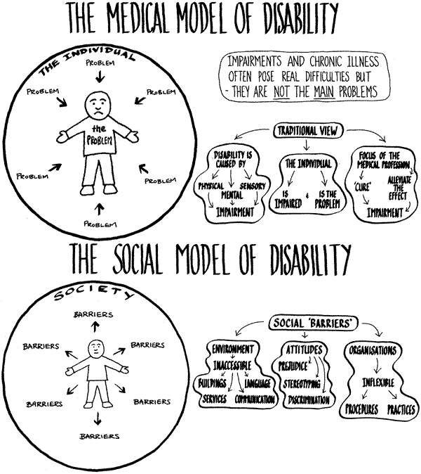
Medical Model | Social Model
Disability is a deficiency or abnormality | Disability is a difference
Disability resides in the individual | Disability derives from interaction between an individual and society
The remedy for disability- related problems is cure or normalization of the individual | The remedy for disability-related problems is a change in the interaction between the individual and society
The agent of remedy is the professional who affects the arrangements between the individual and society | The agent of remedy can be the individual, and advocate, or anyone who affects the arrangements between the individual and society
Notes:
The Social Model views disability as a consequence of environmental, social and attitudinal barriers that may prevent people from fully participating in society. The Medical Model views disability as resulting from an individual person's physical or mental limitations, and is not connected to the social or geographical environments. The Medical Model focuses on finding a "cure" or making a person more "normal."
https://aec.uoregon.edu/content/medical-and-social-models-disability
https://www.neurodivercitysg.com/medical-model-vs-social-model.html

Slide 9
Strategies and Practices

Slide 10
3 Key Areas To Consider for Better Care
Communication
Difficulty with change/novelty
Sensory Issues

Slide 11
Thought Experiment: Mentimeter
Notes:
Voting Link: https://www.menti.com/alcqy16mm8n6

Slide 12
Communication
Learn how the client communicates. You may ask the caregiver/family member or the patient.
How does the client expressively communicate? Is it through speaking, an augmentative alternative communication device, etc.
How does the client process communication receptively? Does the client prefer visual aids?

Slide 13
Communication Tips
Use plain language.
Familiar everyday words
Short and simple sentences
Active voice (not passive)
Allow extra time for the client to process.
Learn what your client’s special interests are.
Consider doing demonstrations.
Use visuals.

Slide 14
Visuals
Notes:
https://www.saintlukeskc.org/health-library/discharge-instructions-using-metered-dose-inhaler
https://youtu.be/8eyfZHiJ_4g?si=GhRqzyg9IhOaiKF3

Slide 15
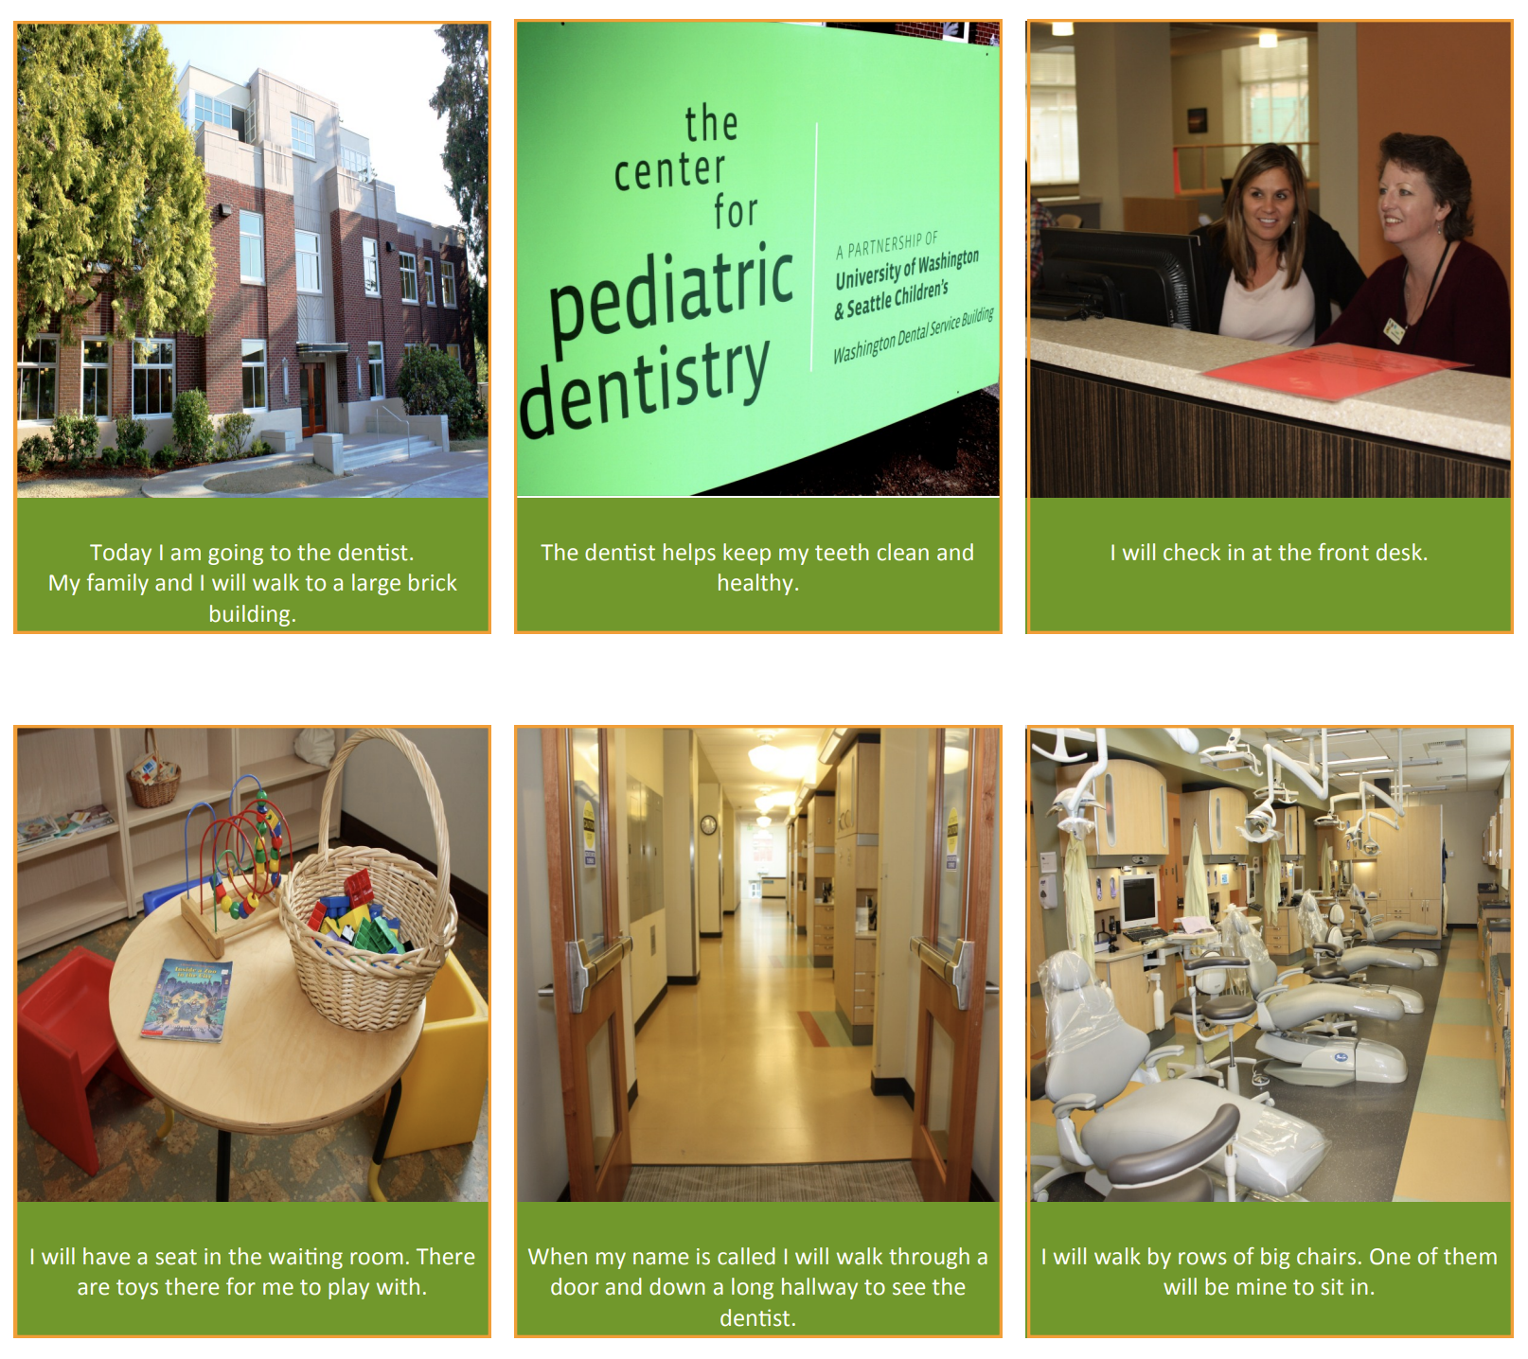
Difficulty with change or novelty
Explain to the client what will happen during your visit
Develop a routine for the client when possible for managing their asthma
Notes:
https://www.pathfindersforautism.org/wp-content/uploads/2017/01/social-story-dentist-by-center-for-pediatric-dentistry.pdf
https://www.pathfindersforautism.org/wp-content/uploads/2017/01/Social-Story-A-Trip-to-the-Dentist-from-Ability-Path.pdf

Slide 16
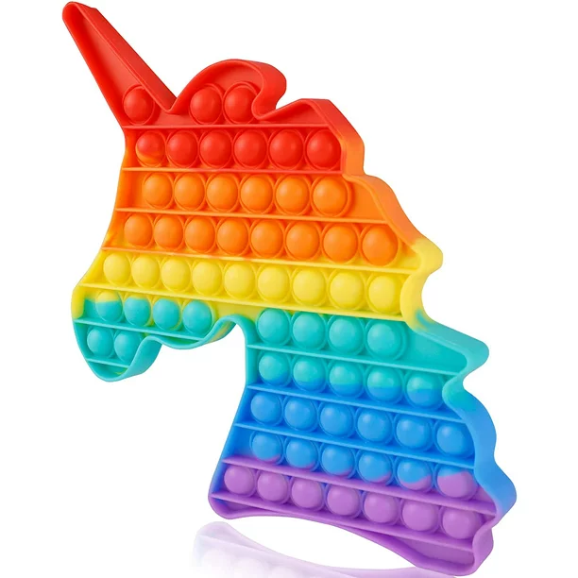
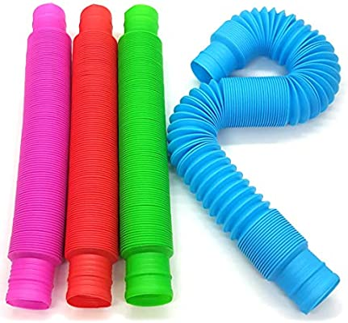
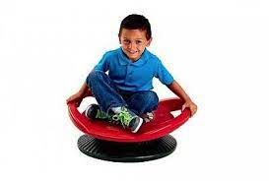
Sensory Issues
Sensory seeking vs sensory avoiding
Sensory avoiding – modify environment (i.e. reduce noise, modify lighting)
Sensory seeking – support client in addressing sensory needs
Consider different options for how the client can use their inhaler
If a nebulizer is too noisy, advocate for a MDI with spacer.
Try distraction and/or reward if sensitive to nebulizer/spacer mask
Notes:
(Kouo & Kouo, 2021)
Through the recommendations of families, Vaz (2010) also recommended the use of rewards to increase engagement in preferred behaviors.
Distraction through the discussion of preferred topics (Sounders et al. 2002; Vaz, 2010), and counting, reciting the alphabet, singing, and toys was suggested to help facilitate medical encounters (Drake et al. 2012; Sounders et al. 2002). Other recommended strategies included allowing patients with ASD to explore devices (i.e., see, touch), and being aware of routines and providing warnings for transitions and sequences of procedural steps (Scarpinato et al. 2010; Vaz2010).

Slide 17
Support Checklist / Medical Passports

Slide 18
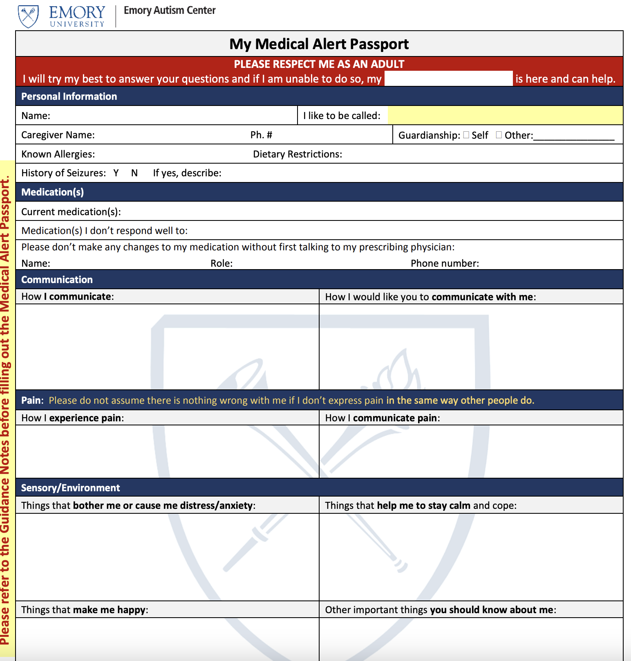
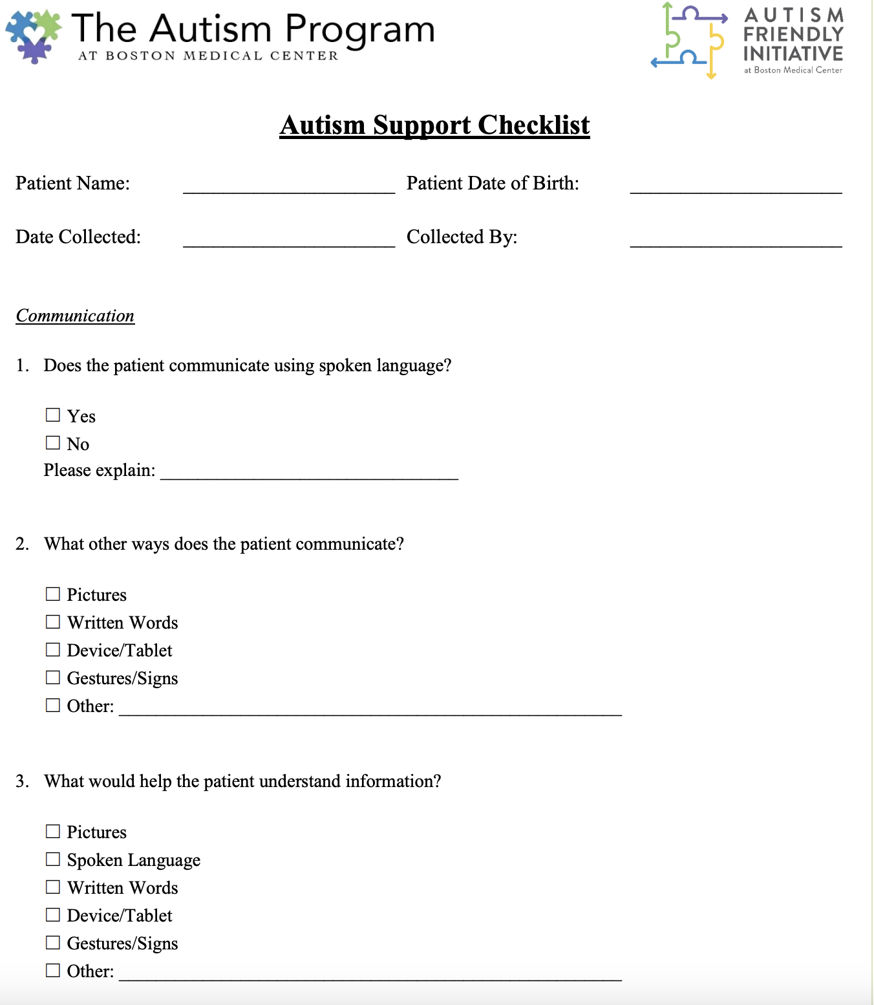
Notes:
Emory U: https://spectrumautism.org/wp-content/uploads/2020/04/My-Medical-Alert-Passport-form.pdf
Boston Medical Center: https://www.bmc.org/sites/default/files/Patient_Care/Specialty_Care/Pediatrics%20-%20Autism/Library/ASC-English.pdf

Slide 19
Notes:
https://dy55nndrxke1w.cloudfront.net/file/24/.ZuLn47.Z3Oq7eJ.ZkJp.0QsoHD/Health_Passport_A4_Editable_2022.pdf

Slide 20
References
A Snapshot of Autism Spectrum Disorder in California | Autism | NCBDDD | CDC. (n.d.). Retrieved November 30, 2022, from https://www.cdc.gov/ncbddd/autism/addm-community-report/california.html
Centers for Disease Control and Prevention. (2019). Data & Statistics on Autism Spectrum Disorder | CDC. CDC.Gov. https://www.cdc.gov/ncbddd/autism/data.html
Kouo, J. L., & Kouo, T. S. (2021). A Scoping Review of Targeted Interventions and Training to Facilitate Medical Encounters for School-Aged Patients with an Autism Spectrum Disorder. Journal of Autism and Developmental Disorders, 51(8), 2829–2851. https://doi.org/10.1007/s10803-020-04716-9
Lu, S., Sonney, J., & Kieckhefer, G. M. (2014). Asthma management in children with autism spectrum disorders: Pearls for a successful clinical encounter. Journal of Pediatric Health Care, 28(6), 559–564. https://doi.org/10.1016/j.pedhc.2014.04.002

